Slide 1
DEVOPS TRAINING

Slide 2
Description
Create a training curriculum around DEVOPS utilizing DEVOPS concepts and solutions
Why?
Learning DEVOPS is like learning to write software WITHOUT having a problem to address
So, learning DEVOPS concepts while using DEVOPS tools will help to reinforce the concepts and ideas

Slide 3
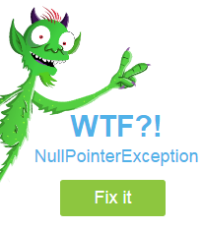
Background
Traditional DEVOPS at an Enterprise level was to maintain two silos (dev and ops) and bridge the chasm with management process.
Issue: When problems occur, finger pointing (accountability) of problem ownership and lengthy delays (recreating the environment) to resolve issues ensued.

Slide 4
Training Environment
The use case for the training is to develop a DEVOPS lab.
The training will focus on utilizing DEVOPS concepts and tools.
The following Tools will be used in this training:
Git Hub
Puppet
Chef
Docker
Jenkins

Slide 5
Disclaimer
Use of the DEVOPS tool set is not intended to make you an expert on the tools.
The purpose of using the tool set is to expose the student to the tool set in an environment that requires the use of the tools.
This will foster understanding of the tools and applicability towards the problem.
There will be a follow on training session about selling DEVOPS with target market analysis, go to market strategy, professional services offerings, execution, etc.

Slide 6
Prerequisites
Before class starts, take time and sign up for accounts on the following DEVOPS tools services:
Git Hub www.github.com
Puppet www.puppetlabs.com
Chef www.chef.io
Docker www.docker.com
Jenkins www.jenkins.io

Slide 7

Git Hub
What is it:
Git and GitHub is a SHARED code hosting platform for versioning and version control.
Terms:
Repositories – a place to store data sets
Branches – a user copy of a Repository
Commits – Commit changes to a shared Branch
Pulls Requests – Get an update from a shared Branch

Slide 8

Puppet
What is it:
Software solution that provides a continuous automated delivery of infrastructure configuration management.
Uses a pull method
Terms:
Infrastructure as Code – build policies for versioning of configuration management items (e.g. NTP, DNS, etc.)

Slide 9

Chef
What is it:
Software solution that provides a continuous automated delivery of infrastructure configuration management.
Master – Client relationship
Based on Ruby
Uses a Push method – policy mitigation and enforcement
Terms:

Slide 10
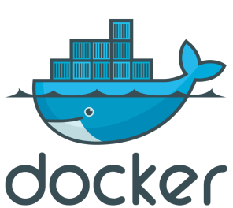
Docker
What is it:
Wraps a software application inside a complete filesystem for execution on top of a shared kernel (e.g. like KVM).
Lightweight – shared kernel
Terms:

Slide 11
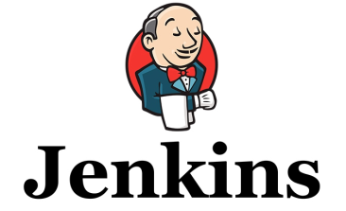
Jenkins
What is it:
Open Source automation server… automates the building of a DEVOPS environment
Terms:

Slide 12
To the lab!!!!!

Slide 13
Step One
Access Git Hub (www.github.com)
Create account
Login
Run the GitHub HelloWorld tutorial
Copy the DEVOPS repository
Load the PLATFORM CENTOS VM for the LAB
The remainder of the LAB will be from the CENTOS container
Bonus: Why are we using a common platform for the lab?
Bonus Bonus: How do you monetize DEVOPS as a partner?
Notes:
Bonus Question Answer: To make sure that all students have a consistent platform for executing the remainder of the lab. This will ensure that the students will not have issues with path or environment variables, versioning and compatibility issues across the different toolsets. The net result is a more efficient and conducive learning experience spent learning the DEVOPS tools, not troubleshooting unique issues between the DEVELOPMENT environment (lab) and the OPERATIONAL environment (the students desktop/laptop). Thereby reinforcing the value of DEVOPS!!!! Yeah!
Bonus Bonus Answer: DEVOPS is conceptually oriented towards an application developer. Most partners are focused on infrastructure maintainers (aka OPERATIONS). The portion of DEVOPS that partners will be able to speak to quickly is the operations piece: infrastructure as a service, infrastructure as code, or software defined infrastructure/data centers. Nominally, these infrastructure software objects are represented as containers, platforms, infrastructure as a code, or infrastructure as a service. At the end of the day, these objects (PaaS, ITaaS, SDDC, APIs) are all the application developer really cares about having access too from operations. They just expect it to work. So, from a partner perspective, we are not selling DEVOPS tools, but services (training or consultative) that teach and guide developers into the adoption of DEVOPS tools and processes. Hence, we will sell PS time to discuss DEVOPS tools and the adoption of orchestration systems for DEVOPS such as vRA, Jenkins, Cliqr, etc.

Slide 14
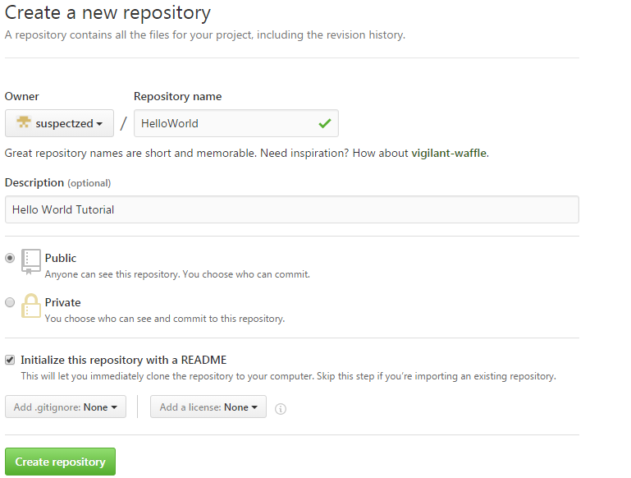
GitHub Tutorial - Repository
Upper Right Corner by Avatar, select “+”
New Repository
Repo Name: HelloWorld
Public
Initiate this with README
check the box
Create Repository

Slide 15
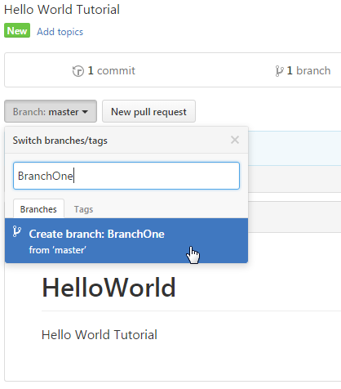
GitHub Tutorial - Branch
Create a Branch of the “HelloWorld” Repository
Select Branch:master
Name: BranchOne
Create Branch

Slide 16
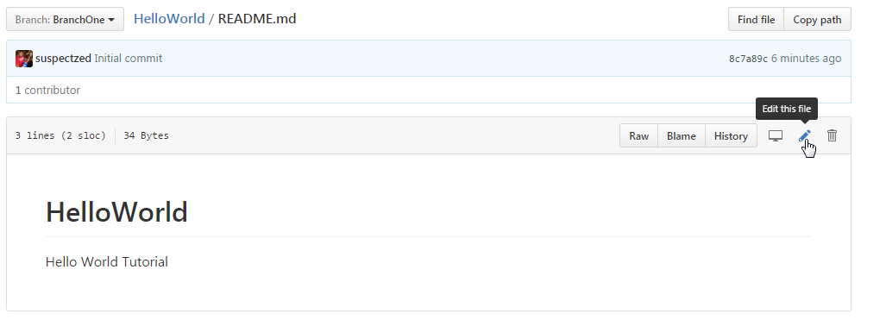
GitHub Tutorial - Branch
Make and Commit Changes:
Click README.md
Select pencil to Edit the file
Select “commit changes” to BranchOne
Commit to Master Branch

Slide 17
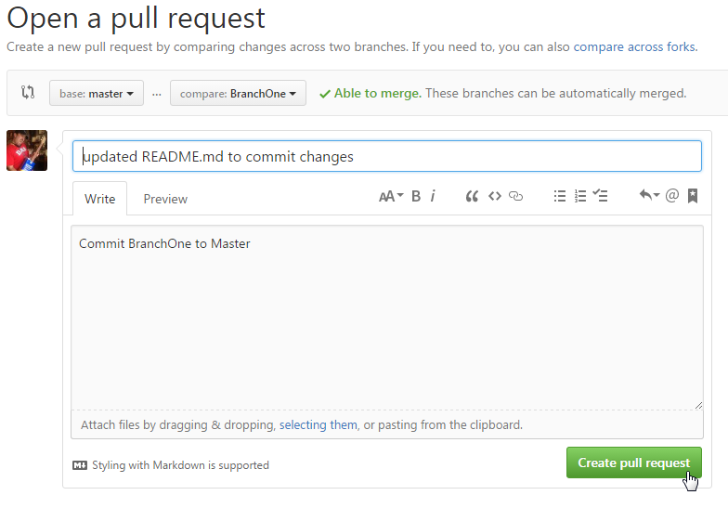
GitHub Tutorial - Branch
Pull Request:
Click “Pull Request” button to have changes reviewed and pulled into the master branch

Slide 18
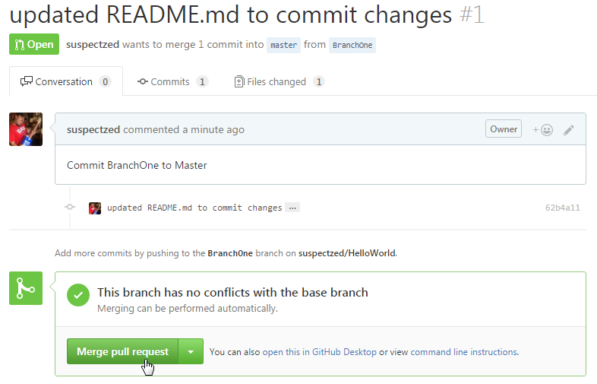
GitHub Tutorial - Branch
Pull Request:
Click “create pull request”
Click “merge pull request” and confirm

Slide 19
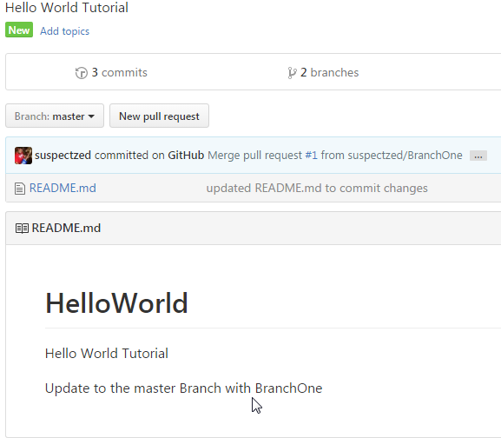
GitHub Tutorial
Upper Left Corner select “code” > Branch = master
Verify changes
to README.md

Slide 20
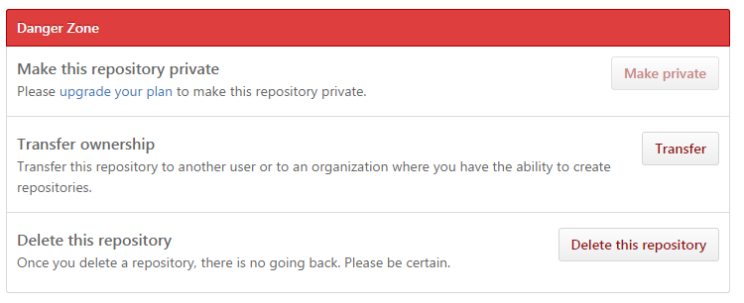
GitHub Tutorial – delete repository
Select the repository to delete
Select Settings (top right of repo)
At the bottom, select delete

Slide 21
Step Two: Build the platform
Standup the DEVOPS platform:
We need to setup a virtualization environment that works consistently across all students. The chosen platform is virtualbox for the lab (open source/free/multihost OS).
Download virtual box
http://www.virtualbox.org
5.1.14 (latest as of writing)
Windows 7 users, install as follows with NDIS5 support:
<VirtualBox-filename>.exe -msiparams NETWORKTYPE=NDIS5

Slide 22

Step Two (cont’d)
On GitHub, Fork the training lab “eplus-trainer\DEVOPS_LAB” repository in GitHub to your personal GitHub repository
Select the ‘+’ in upper right corner
Import repository
Location: https://<path to “eplus-trainer\DEVOPS-LAB”>
Name the repository “DEVOPS_LAB”
In the upper right corner, select the fork icon
Select “begin import”

Slide 23
Step Two (cont’d)
Browse to the DEVOPS_LAB repository folder on your PC.
Open the folder called PLATFORM_CENTOS
Double-click the “Platform_CENTOS.vbox” file
This should open virtual box
Power on the virtual machine in normal mode
This VM has KDE Plasma GUI
Login as: devops/qwerty12
The devops user has sudo priviledges
If you need to access root, it’s root/qwerty12

Slide 24
Step Two (cont’d)
You have successfully completed step two if you can access the KDE Plasma GUI and:
open kconsole
Ping 4.2.2.2
Nslookup www.google.com
Open Google Chrome
Browse to http://www.eplus.com
Open kconsole
[user@host] docker pull hello-world
Status: Image is up to date for hello-world:latest

Slide 25
Step Three: Docker Lab
Recap Docker (what is it?, why use it?)
In the Docker lab we will:
Build a basic run-time Docker image
Build a Docker Recipe and Create a Docker image from that recipe.
Build the Docker Recipe’s and Create the Docker images for the remaining Puppet, Chef, and Jenkins labs.

Slide 26
Step Three: Docker Lab
Example 1: Build a Docker image
Open the Kconsole:
Type the following:
docker images
// the images repository should only have the ‘hello-world’
// image created at the end of step two
docker run docker/whalesay cowsay hello-world
Did you get any output? What was it?
Notes:
The above command provides a run-time build of the ‘docker/whalesay’ image. If the image is local use it (in our case it is not).
If the image does not exist, go get it from the Docker repository and add it to the local Docker container repository.
The image ‘docker/whalesay’ is based on Ubuntu and has the application ‘cowsay’ as part of its build.
The text ‘hello-world’ at the end is passed as an argument to the cowsay application inside the container whalesay and the stdout it displayed.
To show the docker container images use: docker images

Slide 27
Step Three: Docker Lab
Example 2: Build a recipe and create an image
Check the provided Docker recipe:
cd /home/devops/devopslab
more Dockerfile
//read the file contents
Build and run the image (note the ‘.’ in the command):
docker build –t docker-whale .

Slide 28
Step Three: Docker Lab (contd)
Create three Docker containers for each lab:
Puppet
Chef
Jenkins
Bonus: Can you run the Docker engine on a Docker Container?
Notes:
Bonus: Yes. Why would you want to do that….? If the DEVOPS platform was Docker, you could standup Linux servers through an orchestrater (like AWS or Jenkins), have a baseline / desired Docker Engine and Docker image repository setup by Puppet or Chef. Then, using the Docker engine, deploy a specific application stacks (n tiered applications) with traffic workflows already defined.
So, a DEVOPS developer could rapidly automate the creation of the infrastructure environment with a known configuration controlled baseline that is controlled by GitHub.

